Slide 1

Cyclistic Consumer Behavior
Differences in behaviour between yearly and casual rider

Slide 2
Task: How to convert casual member to yearly subscription member
What are the differences in behaviour between casual cyclist and yearly subscription cyclist?
20XX | 20XX | 20XX | 20XX

Slide 3

Dataset
We use Cyclistic’s ride data on the month of May which encompasses ride origin and destination, duration of ride, bike type, and more.

Slide 4
Data Cleaning and Transformation
Data Transformation
Data Cleaning
Data Exploration
Created Duration Column, Month Column, Differentiate between casual and sub member, and create pivot table
We Dropped missing data from the dataset and check duplicates
We explore information that the data has, such as column and statistical information

Slide 5

My Findings:
Differences between casual and subscription member

Slide 6
Casual Member Behaviour
Casual Rider Typically rides for longer duration (2 times more)
Casual Rider don’t ride our bikes as often but usually rides for longer
Casual member rides electric bikes more than subs member but overall tends to ride classic bike
The number of casual riders that rides our bikes in the weekday is stable but increases considerable at the weekends

Slide 7
Subscription Member Behaviour
Subscription member rides our bikes more often than casual member
Subscription Member tends to ride for a shorter period of time
Subscription member likes to ride classic bikes
Subscription member likes to ride our bikes at weekdays especially on Tuesday and Wednesday and drops at its lowest point on the weekends

Slide 8
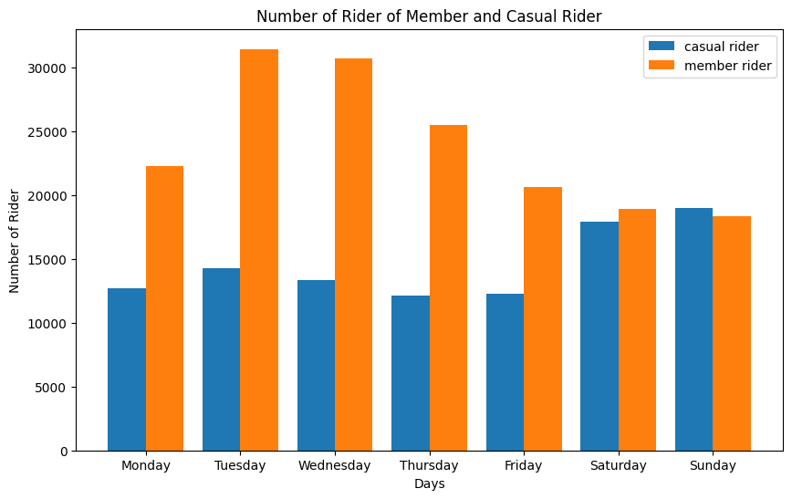

Slide 9
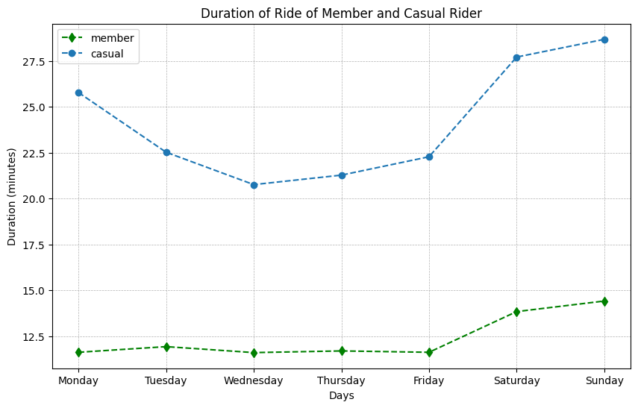

Slide 10
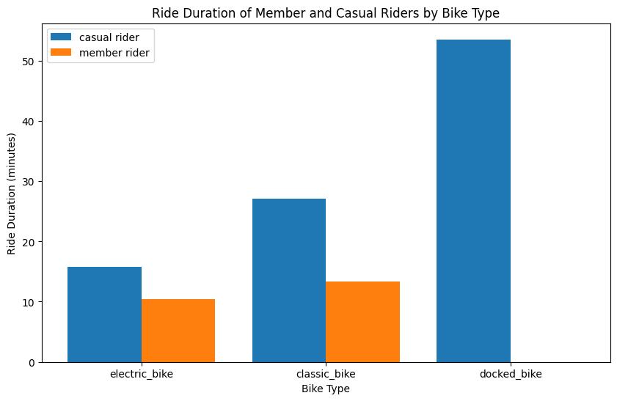

Slide 11

Initial Recommendation
We recommend focusing on benefits of being a member in terms of duration of rides.
Marketing about using bikes to work might also work. How using bike saves fuel cost and the environment
Upgrading the classical bike will benefit both our member and casual rider

